Slide 1
A Look into biodiversity
Nick Jevitz

Slide 2
Key terms to Understand
“No Intervention” – Species that are not endangered and do not require protection
“Species of Concern” – Species that show declining populations and may require conservation efforts
“Endangered” – Species seriously at risk of extinction
“Threatened” – Species vulnerable to endangerment in the near future
“In Recovery” – Formerly endangered, but currently not in danger of extinction throughout a significant portion of their population

Slide 3
Overview of species
Grouping data leads to the following conclusions:
Most species fall into category: “No Intervention”
15 species fall into “Endangered”
4 are “In Recovery” and 10 are “Threatened”
However, 151 species fall into category: “Species of Concern”
These species show a possible need for conservation

Slide 4
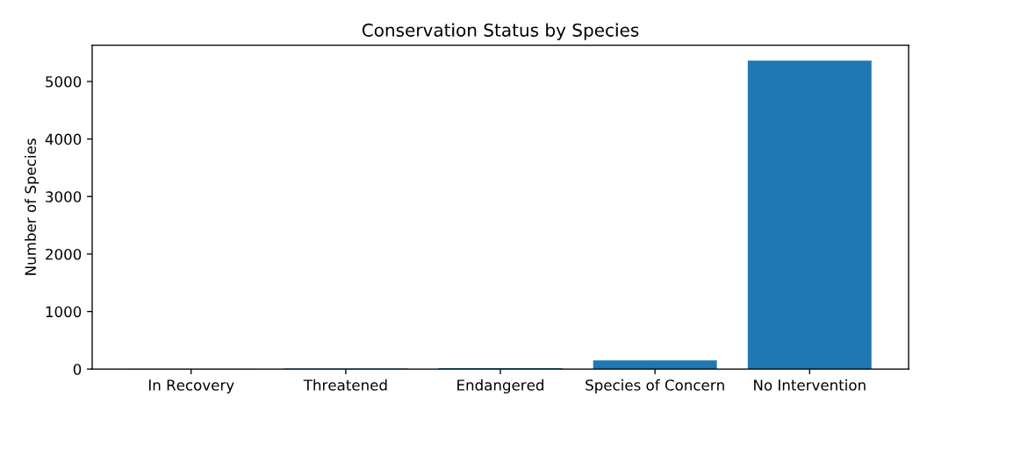
Plotting conservation status

Slide 5
Investigating Further
Further Investigation of endangered species leads to the following results:
Category | Not protected | Protected | Percent Protected
Amphibian | 72 | 7 | 8.86%
Fish | 413 | 75 | 15.36%
Bird | 115 | 11 | 8.73%
Mammal | 146 | 60 | 17.04%
Nonvascular Plant | 328 | 5 | 15.01%
Reptile | 73 | 5 | 6.41%
Vascular Plant | 4216 | 46 | 10.79%

Slide 6
Testing significance between groups
We would like to test if one group is truly more likely to be endangered than another
Solution: A chi-squared test
Comparison between birds and mammals
Null Hypothesis: Difference is due to chance
Results: Fail to reject Null because p-value > .05

Slide 7
Further testing
Testing the difference between mammals and reptiles
Significance level is set at .05
Null Hypothesis is same as in previous test
Results: Reject null hypothesis because p-value < .05 and conclude that mammals are more likely to be endangered

Slide 8
A recommendation
Based on our results we can see that some species are more likely to be endangered than others
This results allows us to understand that some resources may need to be diverted to species that are more likely to become endangered in order to ensure conservation of these species
This extra resources could be obtained from species that have lower percentage of species being protected
Another option is to focus research and more constant monitoring of at risk species before they become endangered

Slide 9
An overview of observations
In this dataset, we are looking at different species at different national park locations
We would like to focus on species with the common name “sheep” included in them
We focus on the sightings of sheep at each park

Slide 10
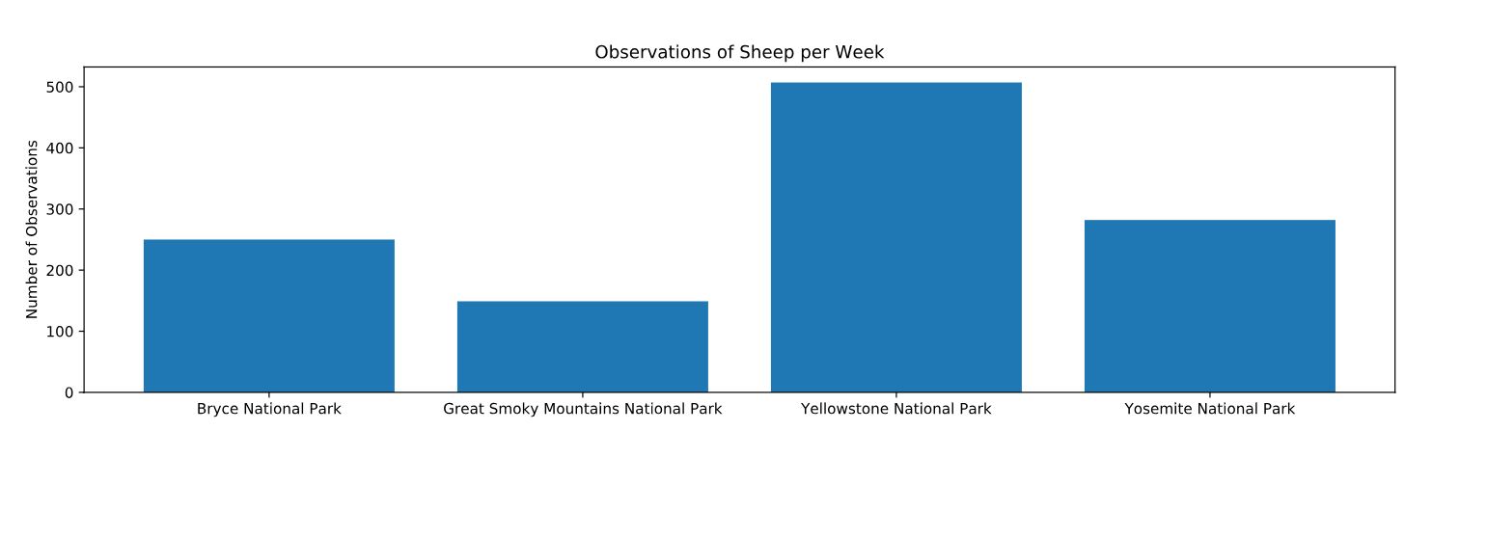

Slide 11
Determining sample size
Yellowstone wants to implement a program that will reduce the prevalence of foot and mouth disease
Must determine, with confidence, how many sheep have the disease
In order to do this, we must determine the appropriate sample size of sheep to test in order to determine overall prevalence of disease with confidence

Slide 12
Determining Sample Size (Cont.)
Baseline Conversion: 15%
Minimum Detectable Effect: 100*5/15%
Statistical Significance: 90%
Resulting Sample Size: 870
Based on these results it will take approximately 1.71 weeks at Yellowstone to have enough sheep sightings to take measurements.
At Bryce National Park, it will take approximately 3.48 weeks to obtain enough observations

